Slide 1

Senior Exit Homeroom
Counseling Department
2024 - 2025

Slide 2

Exit Survey
NWHS Exit Survey
  This is for us – we want to know how to improve to better serve students
  Log into Naviance to complete
  Under the “About Me” at top of screen
    “Surveys from Your School”

Slide 3
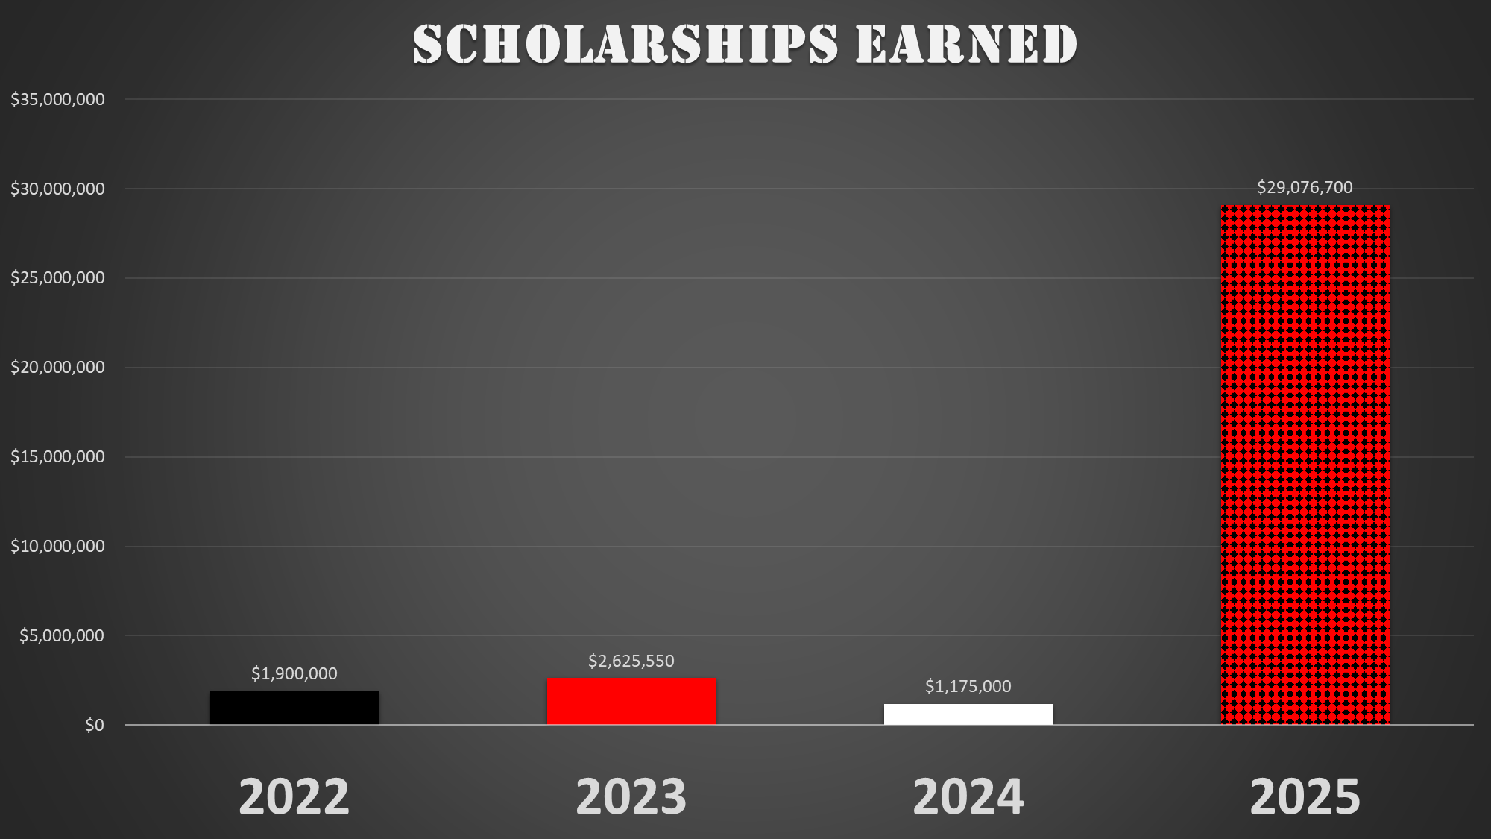
Scholarships
Continue checking Naviance, email and listening to announcements
Continue sending them to me!

Slide 4

Updating College Decisions in Naviance

Slide 5
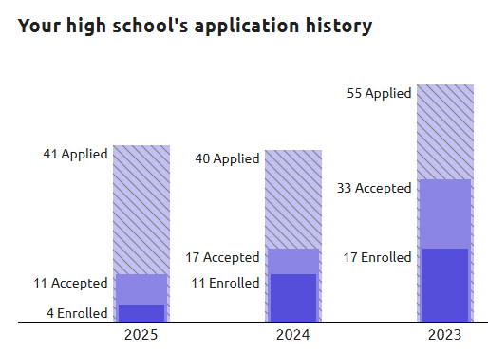
Why Do We Need You To Update App Status?
Purdue University
Main Campus
It is COMPLETELY anonymous
It helps future classes know what their chances are of getting into a university
  Only compares applicants to other NWHS students

Slide 6
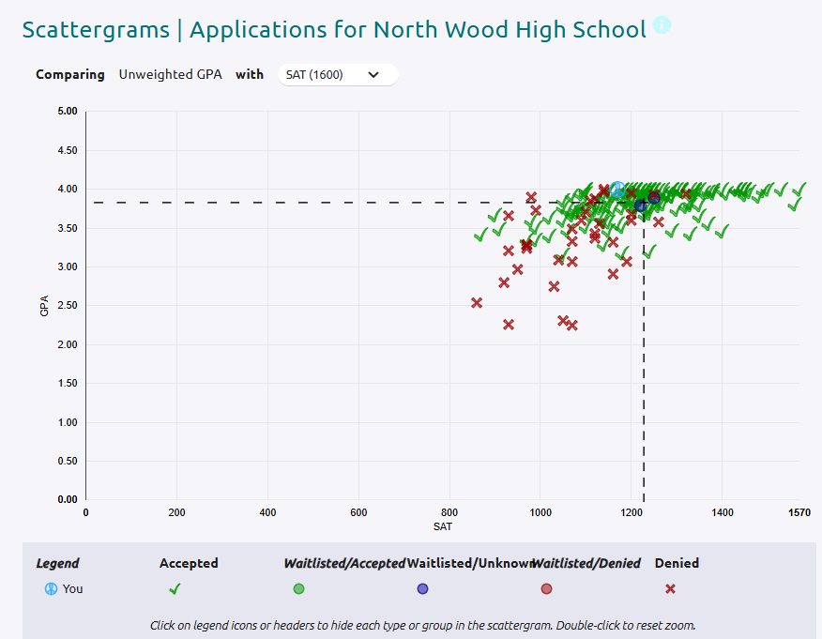


Slide 7
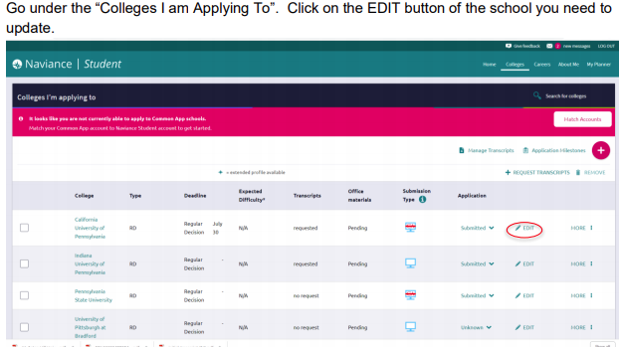
How to Update Application Status in Naviance

Slide 8
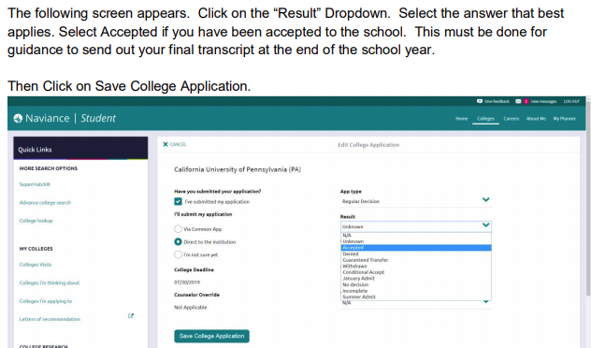
How to Update Application Status in Naviance

Slide 9
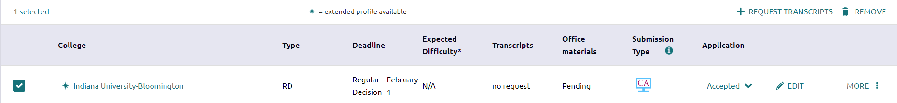
Delete Applications You Never Submitted
On the “Colleges I’m Applying To” tab, select any colleges you never applied to and then click the “Remove” link on the right side of your screen
Note: If we submitted transcripts for you, you won’t be able to delete the application

Slide 10

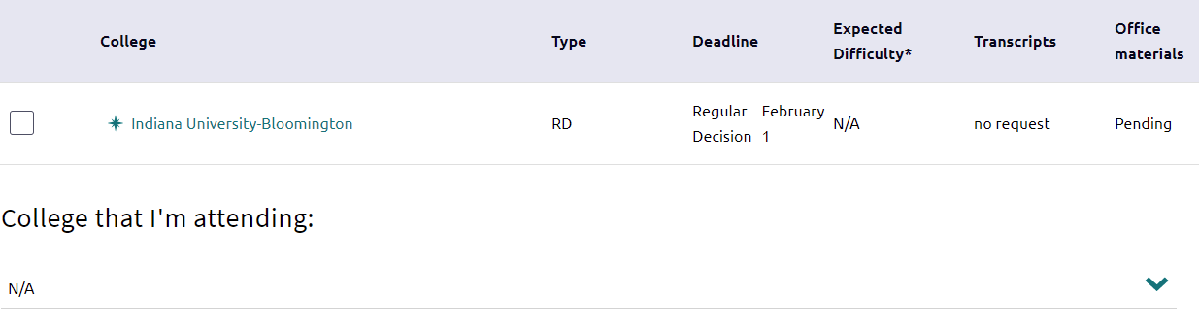
Updating the College You’re Attending in Naviance
Important step before requesting Final Transcripts
Under “Colleges I’m Applying To”, there is a “College that I’m attending” option at the bottom of the screen
Select college from drop down and click on “Update”

Slide 11


Requesting Final Transcripts
A few quick notes….
  If you never requested an initial/midyear transcript through Naviance for the school you are attending, you will not be able to request a final transcript for this school
    Add your attending school into Colleges I’m Applying To and be sure to request an initial or midyear transcript, even though at this point, you don’t need one
  You can only request a Final Transcript once and it can not be changed. Do not do this step until you are sure you know the college you are attending, but please do it before graduation - The counseling staff likes summer break too ☺

Slide 12
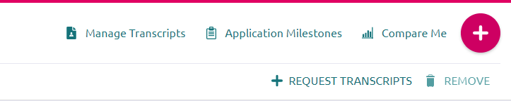
Requesting Final Transcripts
Click on “Colleges I’m Applying To”
Click on “Manage Transcripts” on the right side of the screen

Slide 13
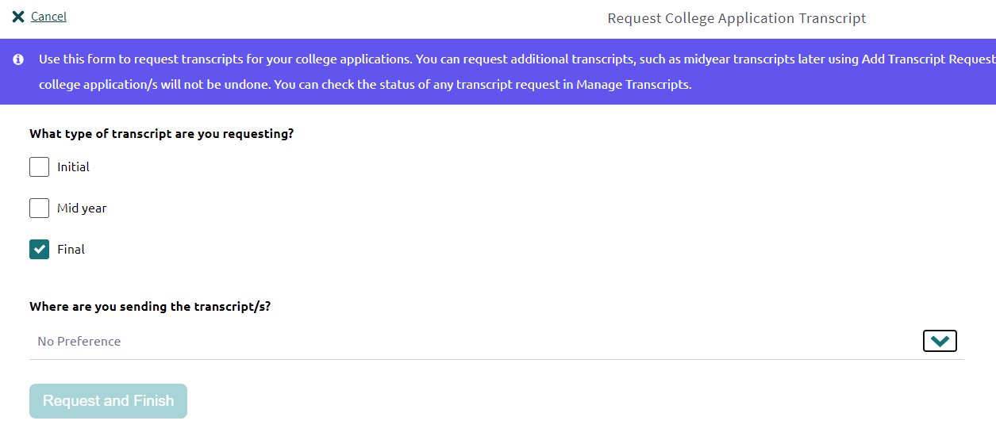
Requesting Final Transcripts
Select “Final”
Use the drop-down arrow to find your school and choose it
Due by Graduation

Slide 14

Ordering Dual Credit Transcripts
#1 – THE COUNSELING OFFICE CAN NOT DO THIS ON YOUR BEHALF. Every year we get calls from graduates and parents wanting to know why we didn’t send your dual credits to your attending college….we can’t request/order COLLEGE transcripts for you, you have to do that.
#2 – Please wait until June 15th to begin ordering these transcripts. Our grades, sometimes for the entire year, are not posted to the college transcripts until then
#3 – We will send you an email towards the end of the school year (several times) with links to each university’s registrar office. Forward this email to your personal email so that you’ll have it when you lose access to your high school email (usually August 1st)

Slide 15
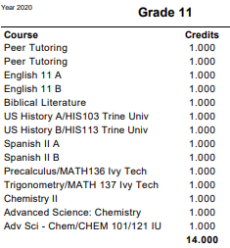

How Do I Know Through Which University/College I Took Dual Credit Classes?
Access your most recent transcript in Skyward under the “Portfolio” tab
All Dual Credit classes and the University/College will be listed on your transcript

Slide 16
Special Announcement for ICC Students
Watch your email for an appointment with Christina Gibson from IUSB
  Final steps to get official Indiana College Core (ICC) designation

